Slide 1
Friend book: A Semantic-Based Friend Recommendation System for Social Networks

Slide 2
Abstract
Existing social networking services recommend friends to users based on their social graphs.
which may not be the most appropriate to reflect a user’s preferences on friend selection in real life.
In this paper, we present Friend book, a novel semantic-based friend recommendation system for social networks.
which recommends friends to users based on their life styles instead of social graphs. By taking advantage of sensor-rich smart phones.
Friend book discovers life styles of users from user-centric sensor data, measures the similarity of life styles between users, and recommends friends to users if their life styles have high similarity. Inspired by text mining.
we model a user’s daily life as life documents, from which his/her life styles are extracted by using the Latent Dirichlet Allocation algorithm.

Slide 3
Abstract
We further propose a similarity metric to measure the similarity of life styles between users, and calculate users’ impact in terms of life styles with a friend-matching graph.
Upon receiving a request, Friend book returns a list of people with highest recommendation scores to the query user.
Finally, Friend book integrates a feedback mechanism to further improve the recommendation accuracy.
We have implemented Friend book on the Android-based smart phones, and evaluated its performance on both small-scale experiments and large-scale simulations.

Slide 4
EXISTING SYSTEM
Most of the friend suggestions mechanism relies on pre-existing user relationships to pick friend candidates.
For example, Face book relies on a social link analysis among those who already share common friends and recommends symmetrical users as potential friends.
The rules to group people together include:
Habits or life style
Attitudes
Tastes
Moral standards
Economic level; and
People they already know.

Slide 5
DISADVANTAGES OF EXISTING SYSTEM:
Existing social networking services recommend friends to users based on their social graphs, which may not be the most appropriate to reflect a user’s preferences on friend selection in real life

Slide 6
PROPOSED SYSTEM
A novel semantic-based friend recommendation system for social networks, which recommends friends to users based on their life styles instead of social graphs.
By taking advantage of sensor-rich smart phones, Friend book discovers life styles of users from user-centric sensor data, measures the similarity of life styles between users, and recommends friends to users if their life styles have high similarity.
We model a user’s daily life as life documents, from which his/her life styles are extracted by using the Latent Dirichlet Allocation algorithm.

Slide 7
ADVANTAGES OF PROPOSED SYSTEM:
Recommended potential friends to users if they share similar life styles.
The feedback mechanism allows us to measure the satisfaction of users, by providing a user interface that allows the user to rate the friend list

Slide 8
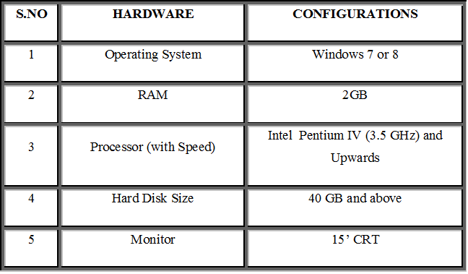
SYSTEM CONFIGURATION HARDWARE CONFIGURATION

Slide 9
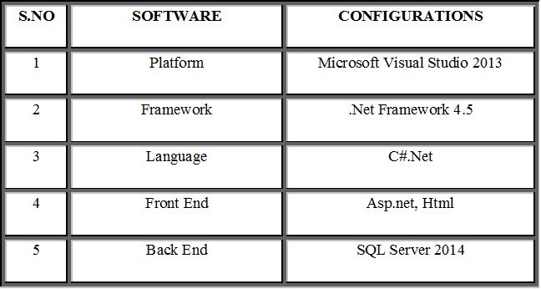
SYSTEM CONFIGURATION software CONFIGURATION

Slide 10
Literature Survey
[1]. G. R. Arce, Nonlinear Signal Processing: A Statistical Approach. New York, NY, USA: Wiley, 2005.
In this paper, we analyze the efficiency of Monte Carlo methods for incremental computation of Page Rank, personalized Page Rank, and similar random walk based methods (with focus on SALSA), on large-scale dynamically evolving social networks. We assume that the graph of friendships is stored in distributed shared memory, as is the case for large social networks such as Twitter.

Slide 11
Literature Survey
[2] B. Bahmani, A. Chowdhury, and A. Goel, “Fast incremental and personalized pagerank,” Proc. VLDB Endowment, vol. 4, pp. 173– 184, 2010.
We present efficient approximate inference techniques based on variational methods and an EM algorithm for empirical Bayes parameter estimation. We report results in document modeling, text classification, and collaborative filtering, comparing to a mixture of unigrams model and the probabilistic LSI model.

